Slide 1


Principles & Practices of Open Research
An online module for undergraduate and Masters students

Slide 2

Module 6 – Knowledge Dissemination
What is the traditional approach to knowledge dissemination?

Slide 3





What is open knowledge dissemination?
Dissemination is the term used to describe how research is shared
It includes the processes researchers use to share research with
other researchers and the general public
Traditional dissemination consisted of the steps outlined in the next slide
To understand what open dissemination is, it is helpful to first think about how dissemination of research has typically been conducted

Slide 4
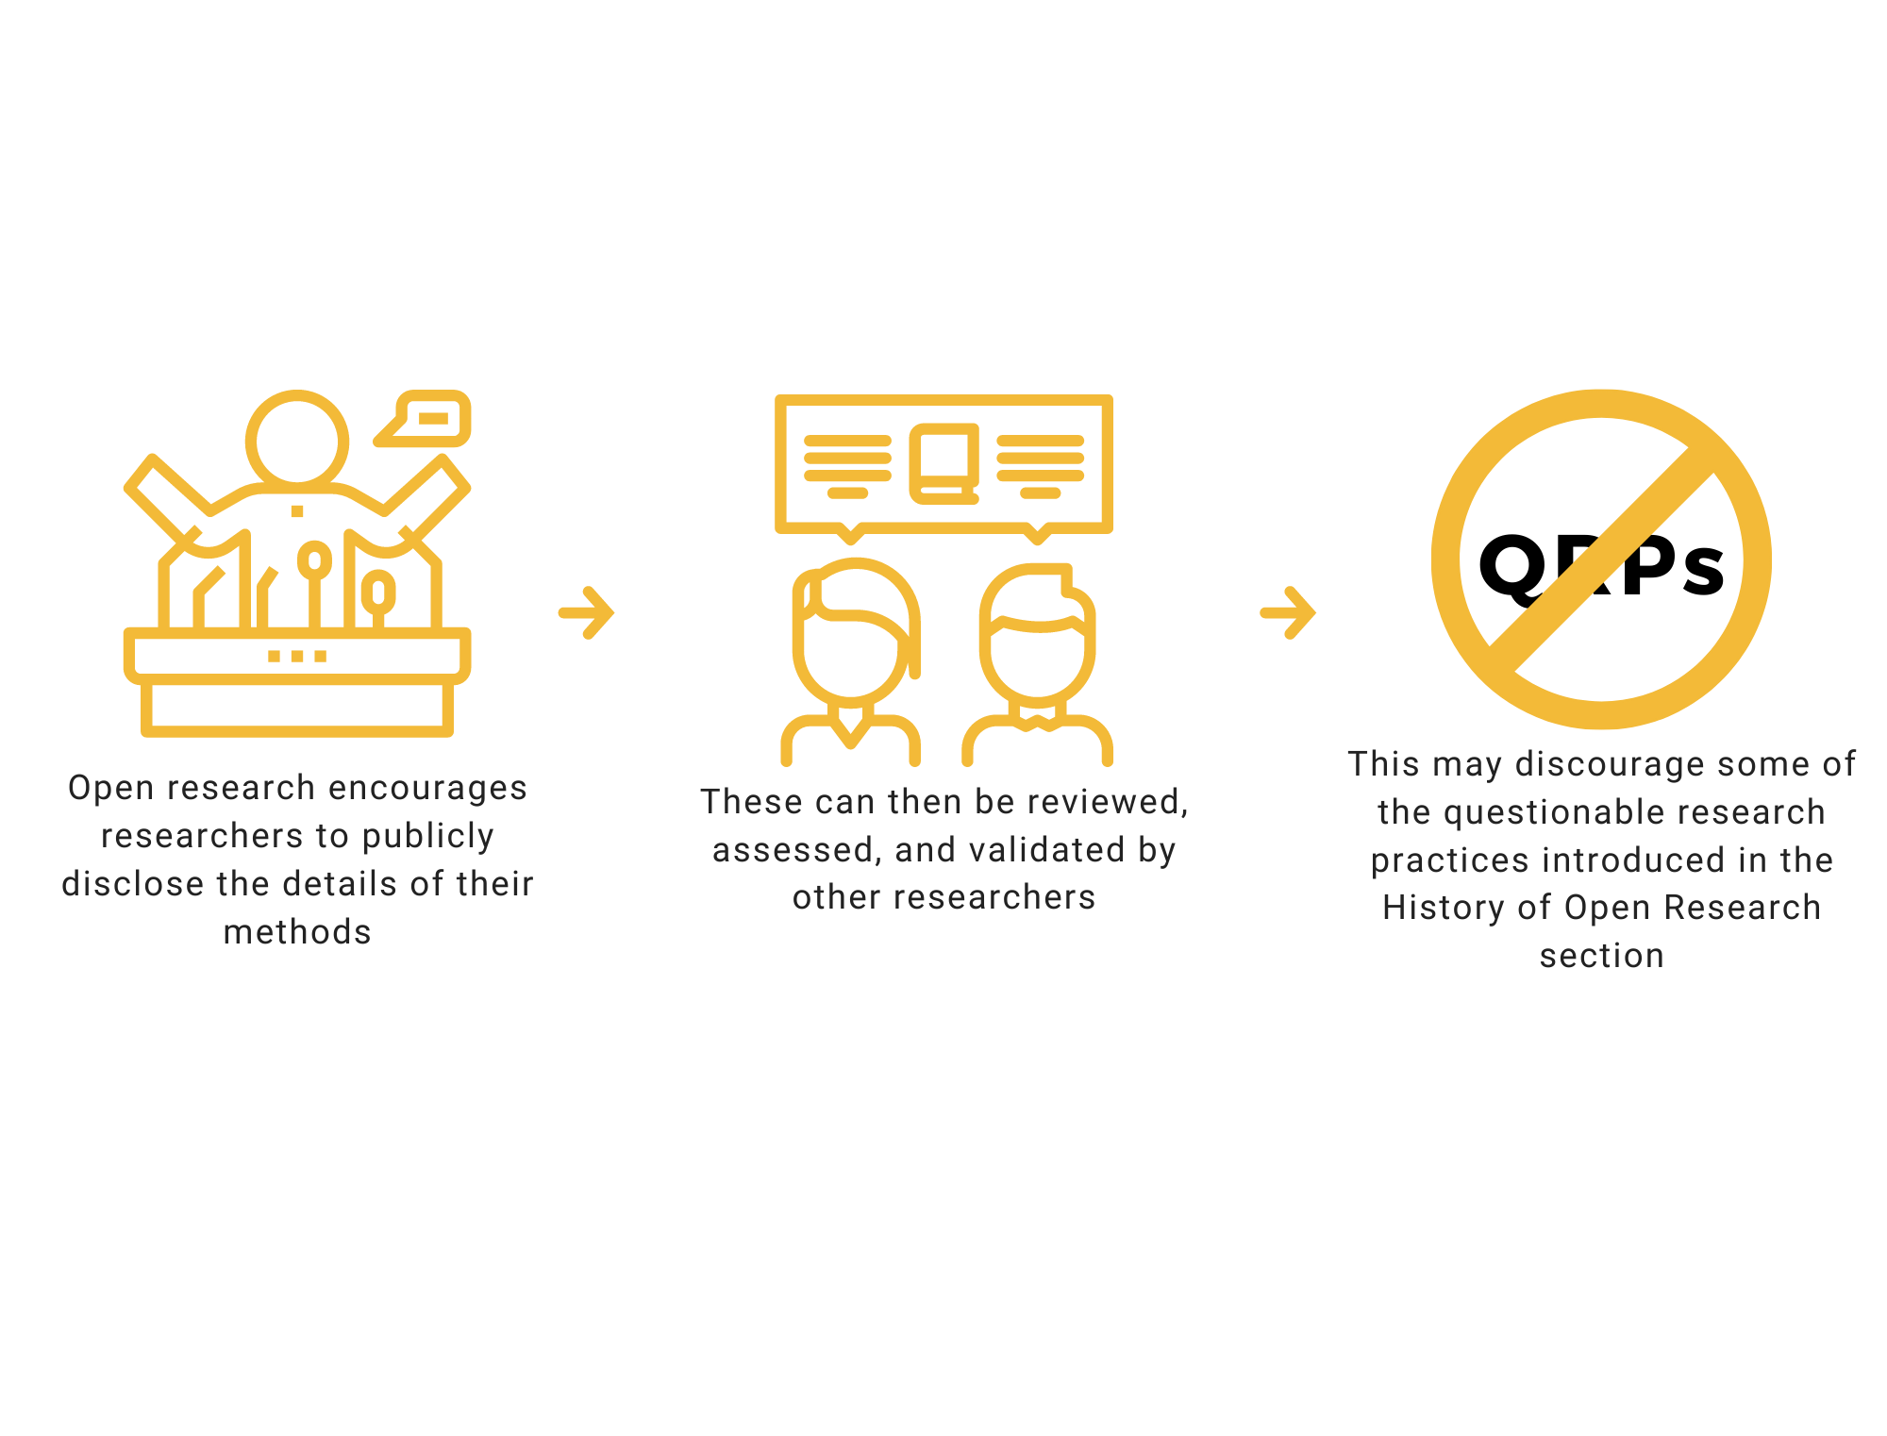


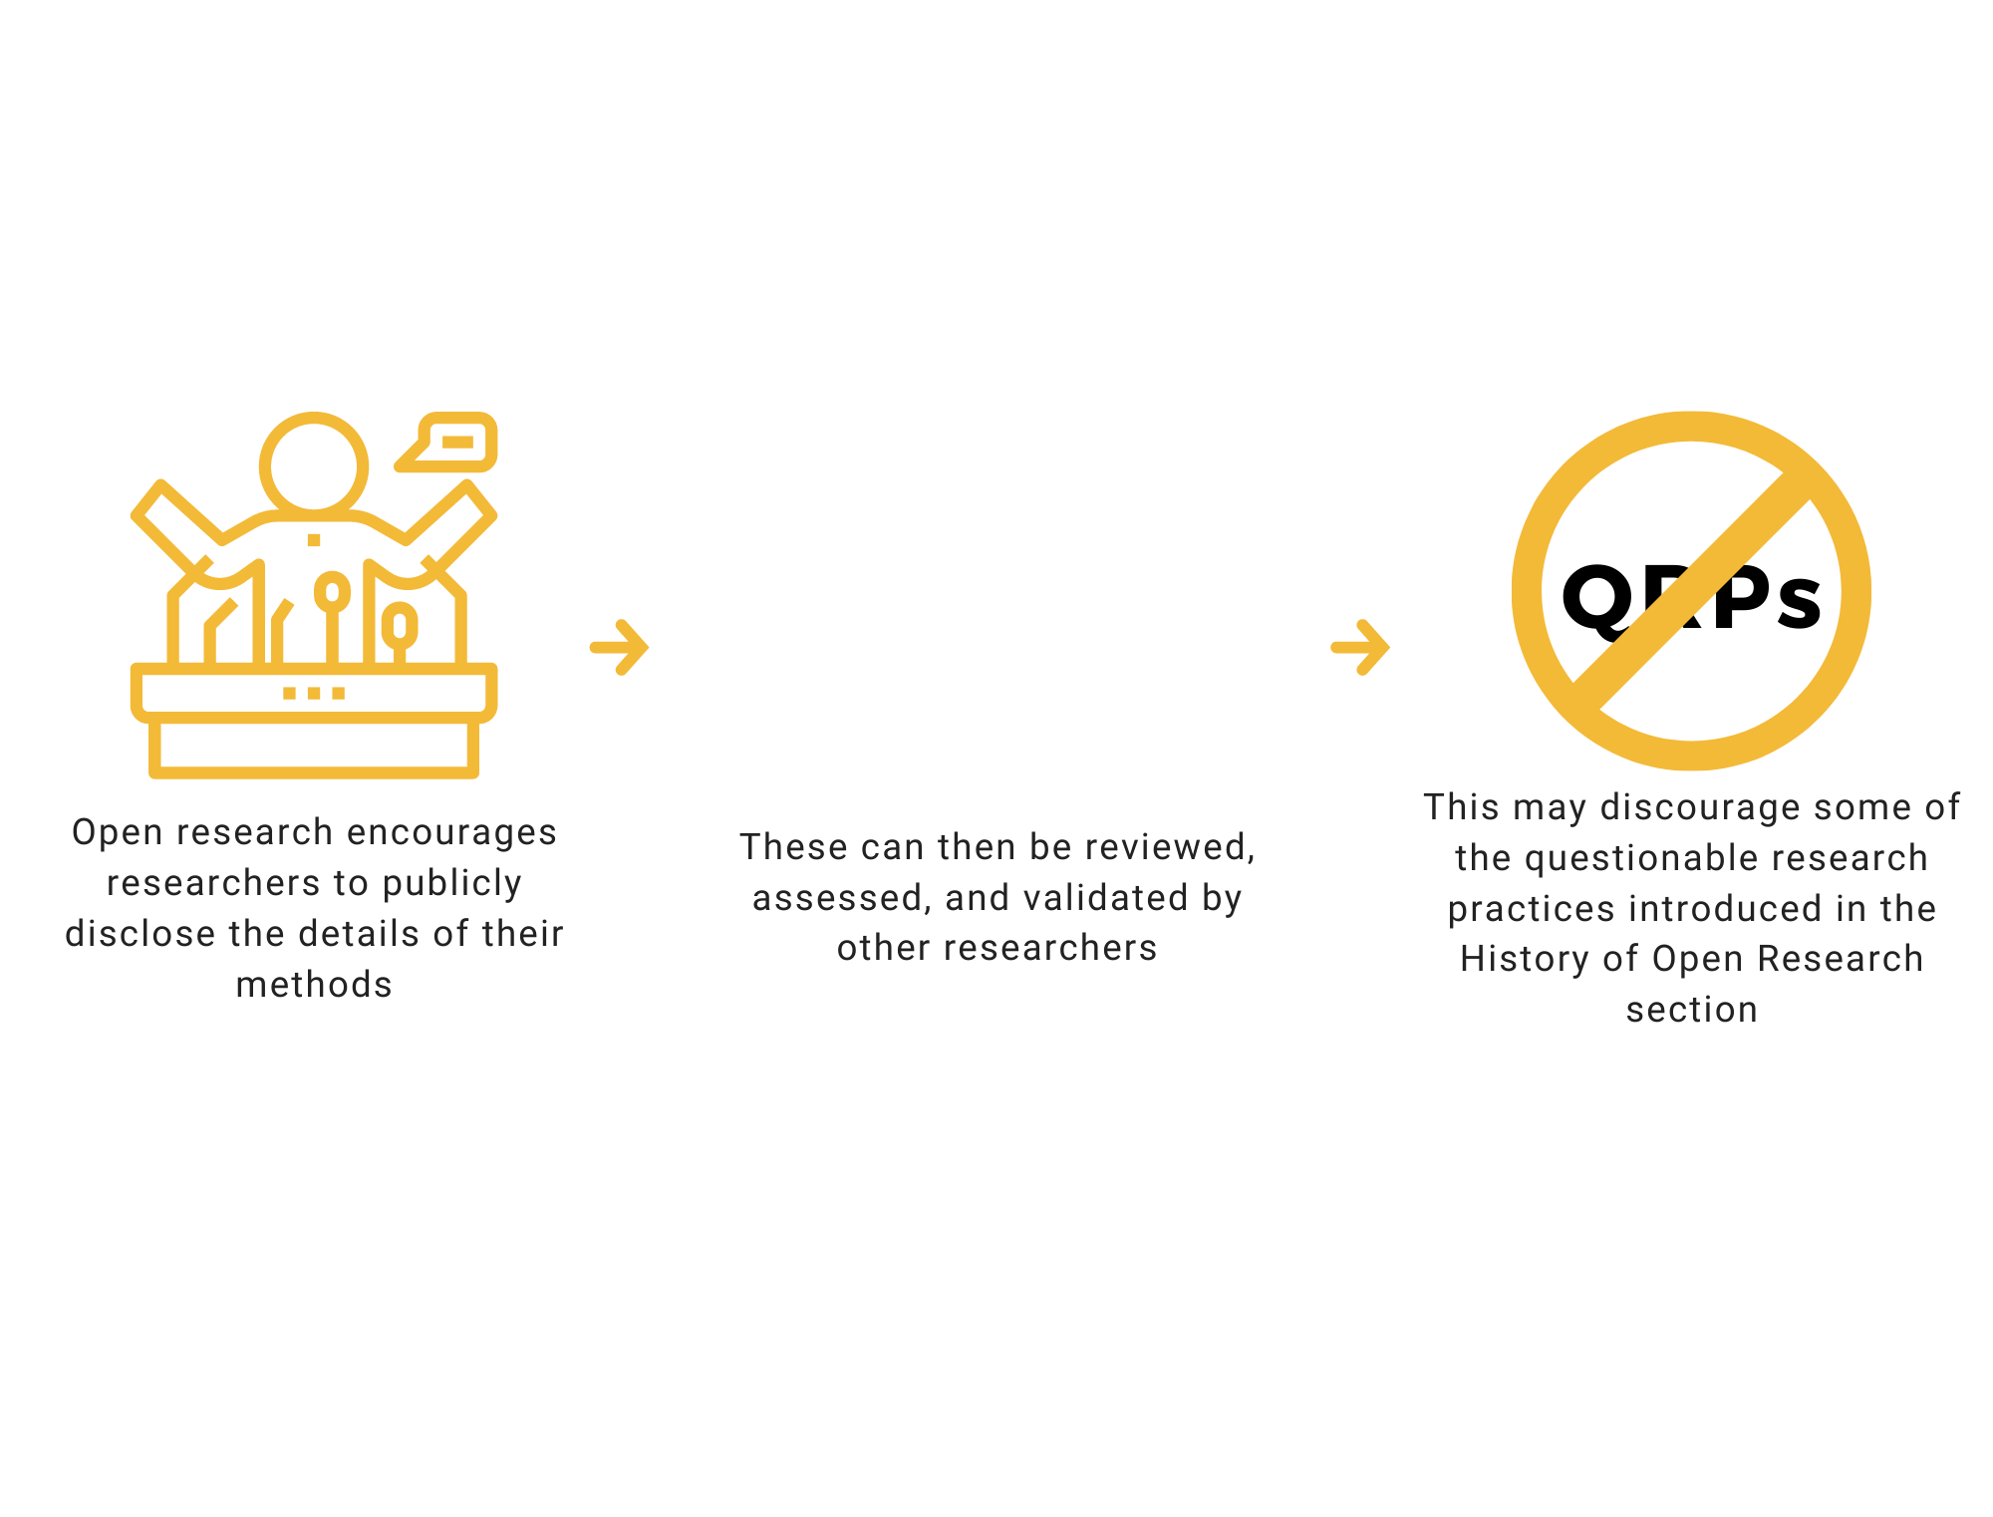
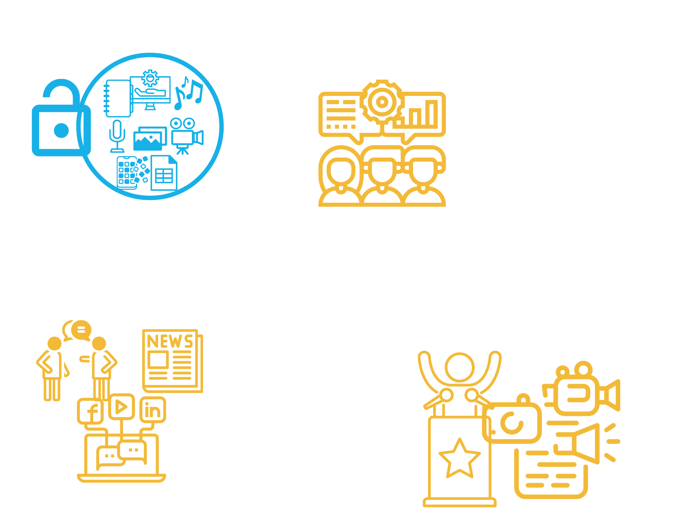
How is research typically disseminated?
Step 1: Designing and conducting research
Step 2: Analysing data and generating results
Step 3: Writing up the research findings in the form of a journal article and submitting this for publication in an academic journal
Step 4: The study undergoes peer-review and a decision is made about whether the article can be accepted, needs to be revised, or is rejected
Step 5: Eventually the article will be published on the journal website and/or in print

Slide 5






What are some of the challenges of traditional knowledge dissemination?
It can take a long time for researchers to get their findings published and for anyone interested to be able to read them
Articles in traditional journals are often behind ‘paywalls’, which means they can only be accessed by paying a subscription or a fee
This makes it harder for people to access information
You have probably already encountered this as a student

Slide 6



What are some of the challenges of traditional knowledge dissemination?
In addition, institutions may subscribe to journals, but not all institutions can afford the same fees
This can create and reinforce inequalities in access to knowledge
and if research is not disseminated transparently, it can’t be learnt from and/or built upon
So paywalls and barriers to accessing knowledge also impact on transparency of research

Slide 7


What are some of the challenges of traditional knowledge dissemination?
Another problem is that the traditional processes may be biased toward publishing novel, exciting, and/or ‘significant’ results
It means that only some findings are available, which can bias our understanding and means we only have an incomplete picture
This is a phenomenon known as the “file drawer problem”

Slide 8


What are some of the challenges of traditional knowledge dissemination?
It is also a big problem because it can influence which questions researchers choose to ask
So, research becomes focused on what researchers can get published, rather than on what we should be examining
It can also incentivise researchers to engage in questionable research or reporting practices to produce novel, exciting and/or ‘significant’ results

Slide 9
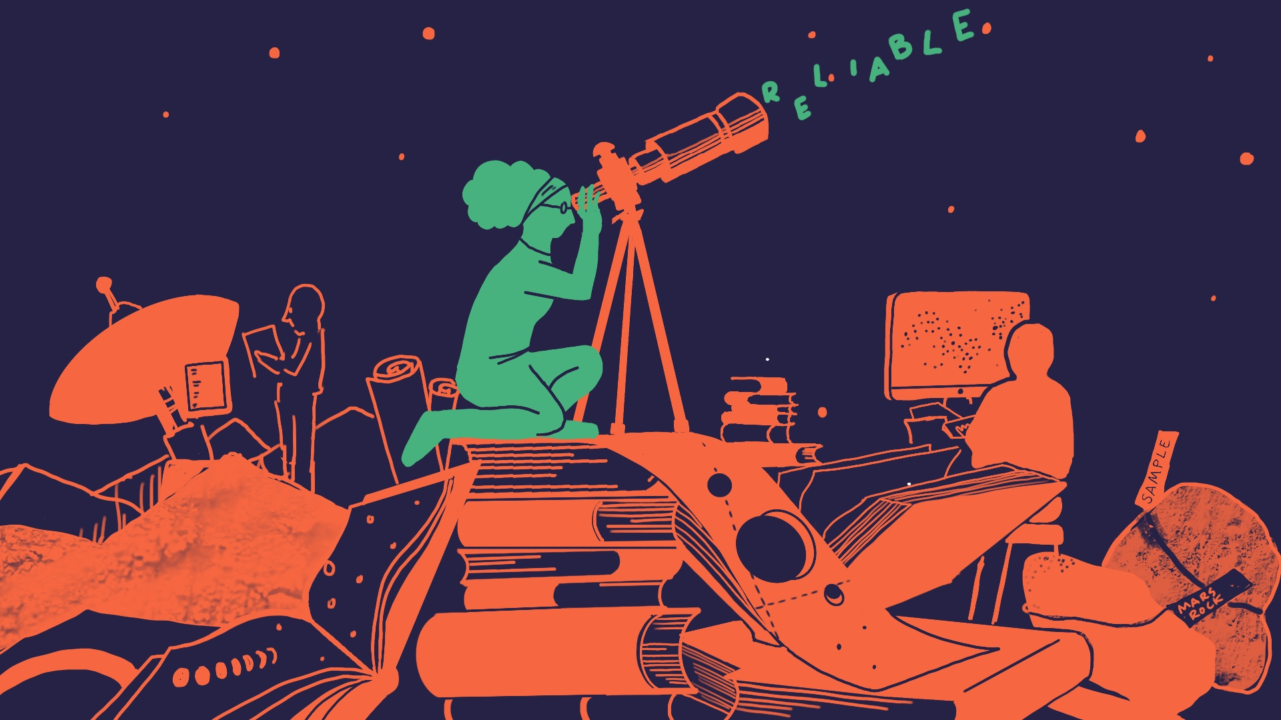

Slide 10
Principles & Practices of Open Research
An online module for undergraduate and Masters students

Slide 11

Module 6 – Knowledge Dissemination
What is open knowledge dissemination?

Slide 12

What is open knowledge dissemination?
1
It involves sharing research more quickly and openly than in a traditional approach
What is open knowledge dissemination?
It includes approaches that can reduce inequalities by sharing information in broader, more accessible ways
2
3
It is not only open access publishing -- although this is an important component

Slide 13

Methods for Openly Disseminating Research
1
Open access publishing
2
Pre-prints
We will take you through these in the following module sections
3
Online repositories
4
Science communication
5
Citizen Science

Slide 14

Potential Obstacles to Open Research Dissemination
Making research papers openly available involves fees that researchers must pay
This is not always possible!

Slide 15
Potential Obstacles to Open Research Dissemination
Some forms of open knowledge dissemination do not require research to be peer-reviewed and checked
This may lead to the dissemination of lower-quality research.
However, the challenges in monitoring quality of openly disseminated research may be balanced by increased transparency and post-publication peer review
It is also increasingly clear that traditional approaches to dissemination do not also ensure quality, either!

Slide 17
Principles & Practices of Open Research
An online module for undergraduate and Masters students

Slide 18

Module 6 – Knowledge Dissemination
Why is open knowledge dissemination important?

Slide 19
Methods for Openly Disseminating Research
Open dissemination methods facilitate:
1
Transparency in research
4
Reshaping of how researchers are rewarded/incentivised to do research
2
Better access to knowledge for individuals and society
5
Rewarding methodological rigor and integrity, instead of just findings
Quicker availability of research findings (compared to traditional routes)
3
Equity in access to knowledge
6
7
Making research more easily accessible, with less/no cost

Slide 20






Why is open knowledge dissemination important?
And the visibility of your research
Open dissemination
methods can also increase your visibility as a researcher
And give you more control over what, when and how you share your research
They make it easier for you to access the research and information you need

Slide 22
Principles & Practices of Open Research
An online module for undergraduate and Masters students

Slide 23

Module 6 – Knowledge Dissemination
Open Access Publishing

Slide 24




What is open access publishing?
Open access publishing means publishing research in a format so that it is made openly available for anyone to read, without any cost to the reader.
There are many dedicated open access journals where people can publish their research openly.
There are also increasing numbers of journals offering an open access publishing option, in addition to the standard publishing approach.
Research funders are increasingly requiring funded researchers to publish their findings open access

Slide 25


What is open access publishing?
Open access publishing has costs for the researcher, though, who usually has to pay fees to make their research openly available
This is a barrier to open publishing
It also reflects a bigger problem of costs in publishing either way: that public money funds research but there are always costs involved for the public to be able to access it!

Slide 26

What is open access publishing?
There are other approaches, like pre-prints, that can help get around these issues- we’ll discuss these soon

Slide 27


Benefits of Open Access
It is easier for everyone, including you, to access research if is published as open access
Open access publishing allows citizens to share in knowledge and evidence on issues that affects them

Slide 28


Benefits of Open Access
Open access publications can increase exposure and impact of your research
Open access publications are reported to receive more media coverage

Slide 29
Benefits of Open Access
A lot of research is funded by public money awarded through grants, so open access makes sure the public can see what they have funded

Slide 30

How do I make my research open access?
If you go on to publish your research project you can consider publishing it in an open access publication
The directory of open access journals provides a list of such journals across multiple disciplines (https://doaj.org/)

Slide 31
How do I make my research open access?
Remember, though, that open access publications can have costs for you as the researcher submitting the paper
You can often apply for open access fee waivers, especially for student work that is not supported by funding
Waivers are not always granted, though, so open access publishing may not
always be possible due to cost

Slide 33
Principles & Practices of Open Research
An online module for undergraduate and Masters students

Slide 34

Module 6 – Knowledge Dissemination
Pre-prints

Slide 35
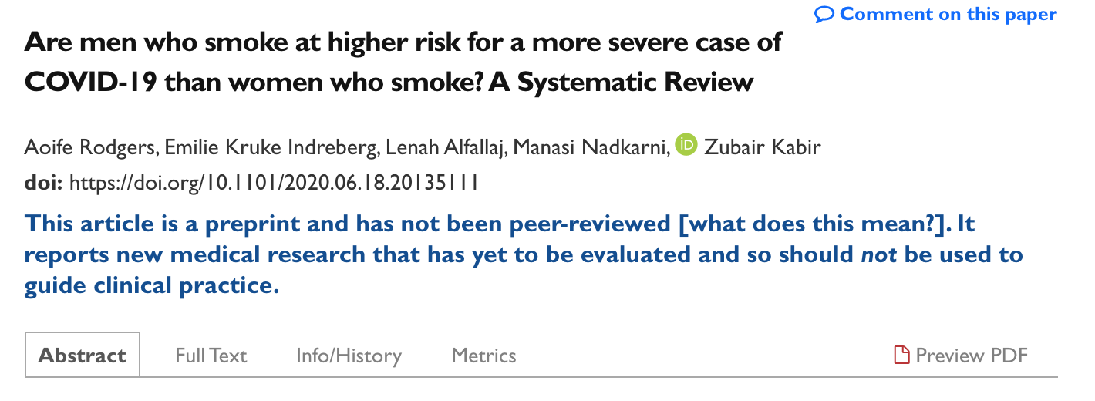
What are pre-prints?
Pre-prints are copies of research manuscripts that have been uploaded to designated pre-print servers before undergoing journal peer review
They are the same manuscript that will be submitted to a journal, so they represent the final work
An example of a pre-print published by students, and their supervisor, from UCC

Slide 36

Benefits and Drawbacks to Pre-prints
Uploading a pre-print of your manuscript allows for free and rapid dissemination of your research
When reading pre-prints, it is important to remember that they have not been peer-reviewed, and so should be read with a degree of caution

Slide 37


Benefits and Drawbacks to Pre-prints
While many journals now have policies allowing and encouraging pre-prints of research articles, some do not accept pre-prints
There are ways to check which journals do and don’t accept pre-prints. We talk more about this shortly

Slide 38
How do I do a pre-print?
If you are planning to publish your research project you can upload a copy of the final manuscript to a pre-print server
You must do this before you submit it to a journal for peer review

Slide 39
How do I do a pre-print?
An important first step is talking to your supervisor about making your research available as a pre-print
Ok, but how do I actually prepare my manuscript and find where to upload it?

Slide 40
How do I do a pre-print?
You should then identify a suitable pre-print server
Some examples are arXiv, bioRxiv, medRxiv, and psyArXiv
You can see examples of pre-prints on any of the above servers to help guide you in preparing to upload your pre-print
As your pre-print is the same manuscript that you will submit to the journal, any changes to your manuscript will mostly be formatting and uploading requirements

Slide 41

How do I do a pre-print?
It is very important to check that the journal you want to publish your manuscript in accepts pre-prints
Sherpa Romeo provides up-to-date information about individual journals’ open-access policies, so check here first

Slide 42
How do I do a pre-print?
Once you are sure your target journal accepts pre-prints, you have identified a relevant pre-print server, and have prepared your paper, you can upload it to the pre-print server!

Slide 44



Why is open knowledge dissemination important?
In addition, funders and journals are increasingly focusing on things like open access
So, if you continue with research, it’s important to be aware of what is involved
But even if you never do research again, open research is important to you as a member of the public
For example, it influences your access to knowledge, and how that knowledge is used to make decisions that impact you

Slide 45

Module 6 – Knowledge Dissemination
Repositories

Slide 46


What are repositories?
A repository is a database for storing datasets or research outputs (e.g. manuscripts).
Many universities have their own repositories for affiliated researchers to use (e.g. CORA in UCC).
Putting research outputs on repositories can make them more visible.
Researchers have control over what is made publicly available when putting data or outputs on repositories.

Slide 47
What are repositories?
Repositories can be domain or discipline specific, or may be more general
Examples of domain specific repositories
Examples of more general repositories
1
1
Lenus (health research)
MLA CORE (Humanities)
Isidore (Social Sciences and Humanities)
Open Science Framework
Zenodo

Slide 48
How do I use a repository?
To upload your research paper/manuscript or data you must first identify an appropriate repository
See the previous slide
Once you have identified a repository, follow the repository guidance to upload your paper or data

Slide 49
An important note on uploading data to a repository!
If you are uploading data to an online repository, make sure you are adhering to ethical considerations and data sharing guidelines
You should also consult your institutional research and data-sharing guidelines and support services
You should complete the PaPOR TRaIL research and data management module to find out more about this

Slide 50
Open Science Framework (OSF)
We previously introduced you to the OSF during the module on pre-registration.
The OSF allows researchers to:
1
Store and make available their research outputs
4
Assign a DOI (Digital Object Identifier) to their projects
2
Manage their workflows and keep projects organised
5
Link projects to ResearchGate/ LinkedIn
3
Store data, analyses, and reports

Slide 52
Why is open knowledge dissemination important?
In addition, funders and journals are increasingly focusing on things like open access
So, if you continue with research, it’s important to be aware of what is involved
But even if you never do research again, open research is important to you as a member of the public
For example, it influences your access to knowledge, and how that knowledge is used to make decisions that impact you

Slide 53
Module 6 – Knowledge Dissemination
Science Communication
Science Communication
G

Slide 54
What is science communication?
1
Sharing research ideas, methods and knowledge with non-expert audiences
2
Sharing these in ways which are useful, understandable, accessible and/or tailored
3
3
The goal is to inform the public
4
This is usually done in engaging ways to also increase interest in research and its outputs, and to influence people’s opinions/behaviours

Slide 55




What is science communication?
Communicating the findings of your research is as important as conducting the research
Science communication is not limited to traditional academic approaches but can incorporate a range of different approaches
And science communication is not just for science!

Slide 56

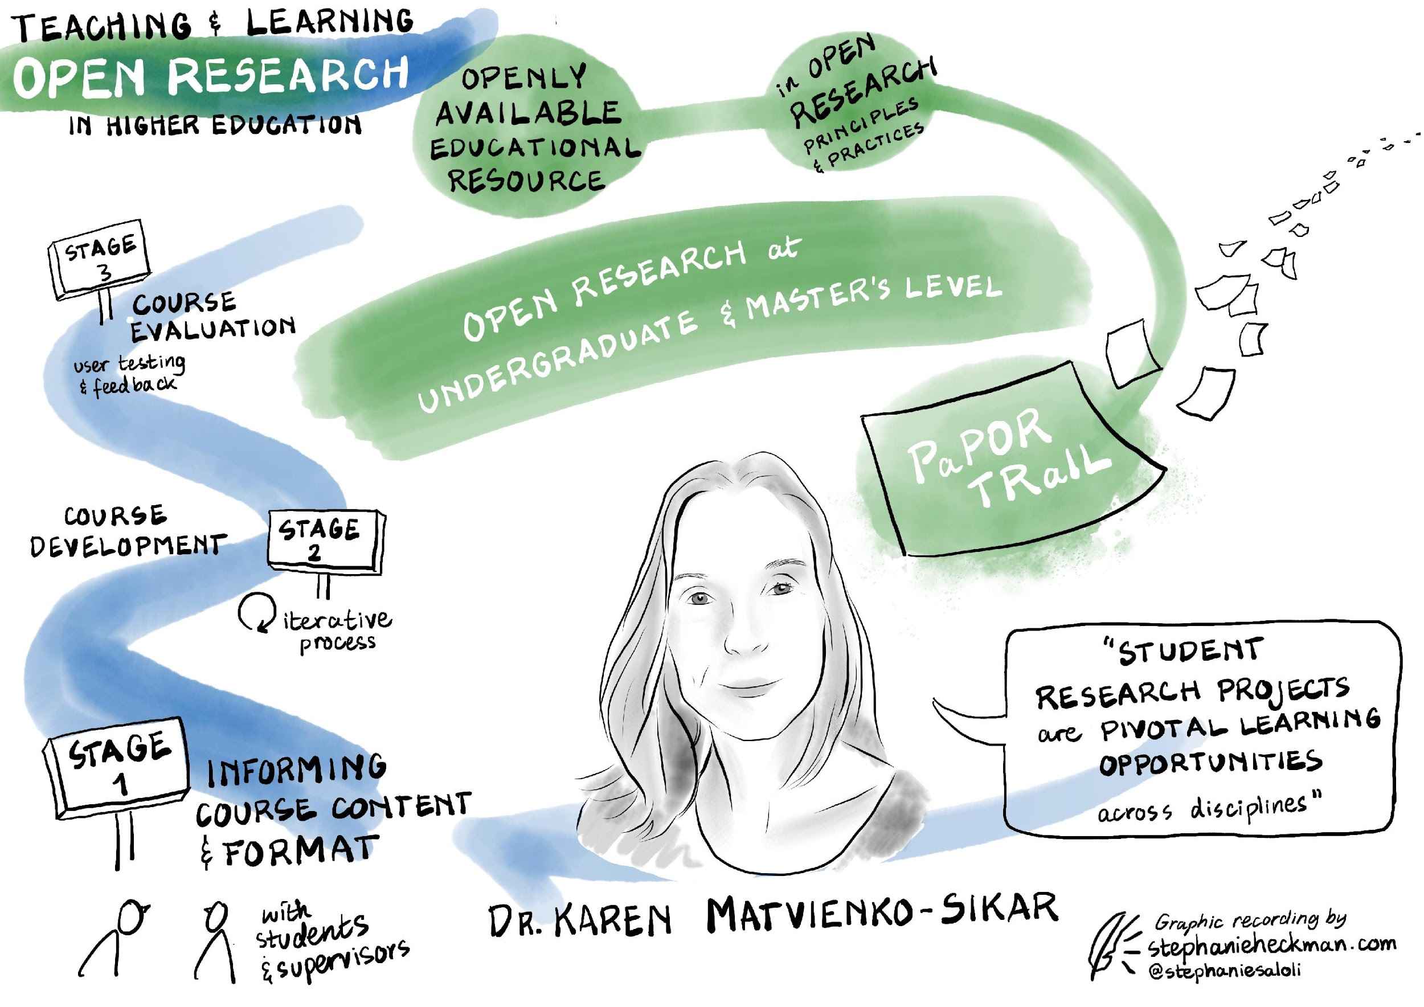
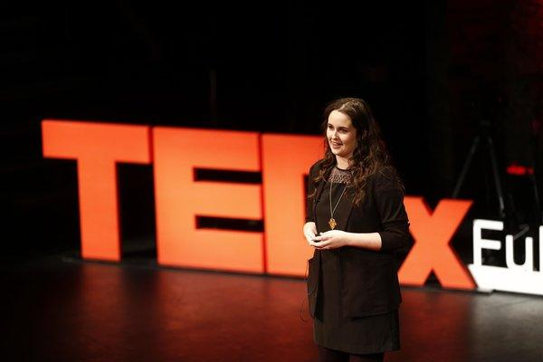
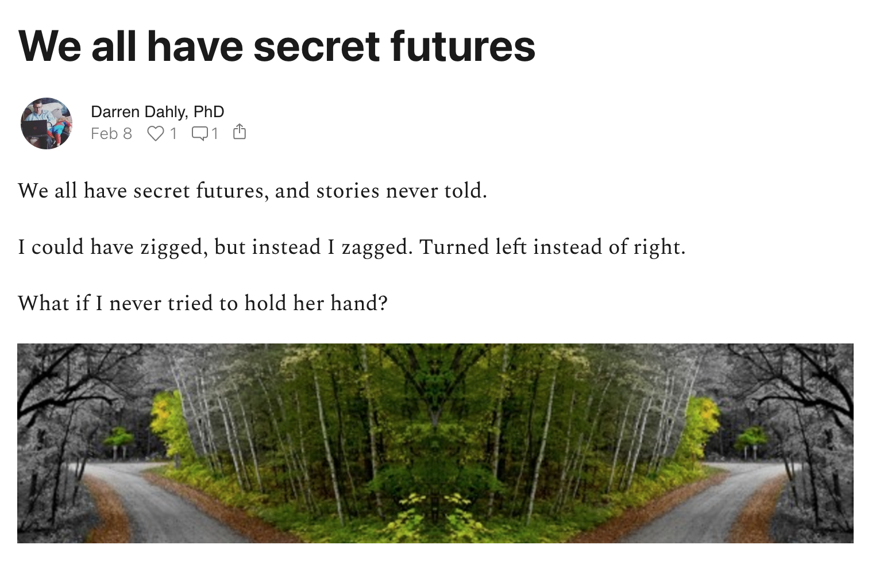
What is science communication?
It can incorporate a range of different approaches aimed at the target audience
Including the wider community or special interest groups (e.g. policy makers)
Images
Blogs
Public talks

Slide 57
What is science communication?
Approaches can include things like:
Public talks (e.g. PintofScience)
Social media, including using Gifs
Check out #bittacake for good examples of student research
Blog posts like this one about personalised medicine
Videos
Using visuals or infographics
Podcasts, like the Orion Open Science Podcast
Newspapers and the media

Slide 58
Benefits of Science Communication
1
It enhances the sharing of research findings
What are the benefits of science communication?
2
It increases public understanding of research
3
It increases public interest in research
4
It can help research to make an impact by reaching target audiences

Slide 59

How do I do science communication?
If you aren’t ready to share your research with the public yet a good starting place with science communication is to see how other people are doing it.
There are likely blogs relevant to your discipline or research interests that you could look at

Slide 60
How do I do science communication?
Graphical abstracts, which visually represent the research, are becoming increasingly common in journal publications
There are thousands of TED and TEDX talks that you can watch.
Twitter threads, Youtube, and other social media include examples of science communication too

Slide 61
How do I do science communication?
Your university may have events and competitions like a ‘3 minute thesis’, where researchers present their research in 3 minutes
There are also local, national and international activities you can attend

Slide 62
How do I do science communication?
Other activities include things like:
Pint of Science, where researchers present their research in a pub-setting
Famelab, which is an international science communication competition for researchers (including research students)
When you are ready to share your research, you might want to take part in some of these activities!

Slide 63






How do I do science communication?
When you are ready to share your research with the public it is important to first identify who is your target audience
Is it everyone, or is it a specific group that your research is most relevant to?

Slide 64


How do I do science communication?
Think about what message(s) you want to share
What are the key findings, the things that are most important for your audience to know?
Think about ways that you can share this information
There are lots of options, like in person talks, or using videos, visual representations, podcasts or blog posts

Slide 65
How do I do science communication?
It is important that you avoid using technical terms or jargon when sharing your research with the public.
You want it to be accessible to everyone
Try to include visuals as well as speaking/text. This can maintain attention and keep it interesting for the audience

Slide 66

How do I do science communication?
Make it relatable!
Remember you are not communicating as a researcher to other researchers.
So only include examples and anecdotes that are relatable to your target audience!

Slide 67

How do I do science communication?
Remember that because science communication aims for inclusivity, it can be difficult for the audience to decide what is reliable information
If you are doing science communication, be sure to support your points with accessible data and/or supporting information
If you are viewing science communication,
put your researcher hat on to determine if the communicator is
supporting their points

Slide 69
Why is open knowledge dissemination important?
In addition, funders and journals are increasingly focusing on things like open access
So, if you continue with research, it’s important to be aware of what is involved
But even if you never do research again, open research is important to you as a member of the public
For example, it influences your access to knowledge, and how that knowledge is used to make decisions that impact you

Slide 70
Module 6 – Knowledge Dissemination
Citizen Science
H

Slide 71
What is citizen science?
1
It is an open and inclusive approach to conducting research
It involves input from the public in the research process as observers, identifying images, or providing or analysing data
2
What is citizen science?
It is an aim of open research because open research works towards inclusivity
3
4
It is also an enabler of open research because including the public in research increases its openness
It is not simply having members of the public involved as participants, they are instead active research partners
5

Slide 72
Benefits of Citizen Science
It promotes research that is conducted for the people and by the people
It enhances public engagement in and with research
It nurtures public investment in and understanding of scientific processes and outputs

Slide 73

Case Study: The People’s Trial
Check out The People’s Trial for an excellent example of citizen science and science communication in action
The public were involved in all stages of the project, from deciding what research question to examine, to deciding how the findings should be shared

Slide 74



Case Study: The People’s Trial
For example, the public were asked to come up with possible research questions
They came up with 155 questions!

Slide 75

Case Study: The People’s Trial
The public then voted on which one they should examine
The question they decided on was:
‘Does reading a book in bed make a difference to sleep in comparison to not reading a book in bed?’

Slide 76
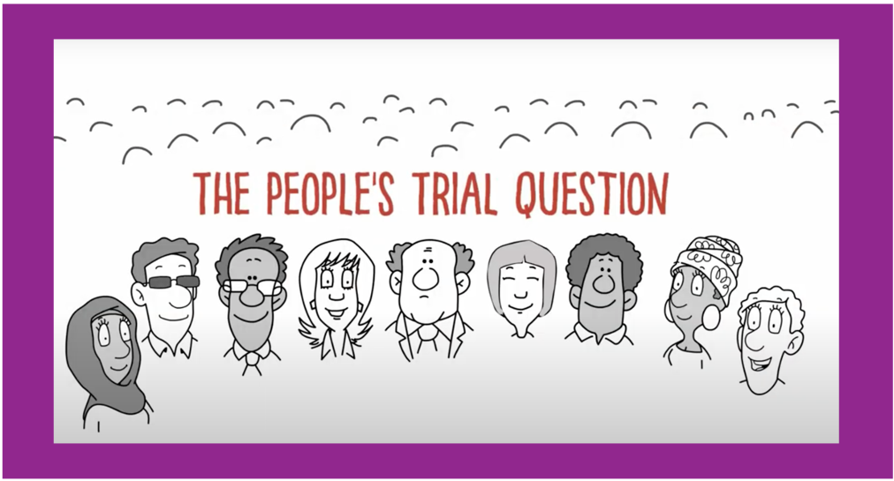
Case Study: The People’s Trial
This video was used to explain the what, why and how of deciding a research question
Find out more about the people’s trial by visiting their website: https://thepeoplestrial.ie/

Slide 77

How do I do citizen science?
Citizen science is a bit trickier to include in a student project
You can get involved in ongoing citizen science projects that you come across
For instance, projects like the All Ireland Ladybird Survey that involves the public in tracking Ireland’s native ladybird population using a smartphone app

Slide 78
Complete an activity on Canvas.
There are 4 to choose from depending on what research stage you are currently at.
You must complete at least one activity, but you can complete more if you like!

Slide 80
Principles & Practices of Open Research
An online module for undergraduate and Masters students

Slide 81
Additional Resources

Slide 82
Want to know more about. . .
How to make knowledge dissemination more open?
Read this preprint called Scientific Utopia: I. Opening Scientific Communication. The title says ‘science’, but it is relevant across disciplines and some sections expand on what we covered here.
The benefits of sharing research openly?
Read this report on ‘How Open Science Helps Researchers Succeed’. Again, this is relevant across disciplines, not just science.
Inclusivity in open research?
Take a look a this openly available presentation on why: good open science must be inclusive

Slide 83
Want to know more about. . .
The benefits of pre-prints for early career researchers?
Read this paper on the benefits of pre-prints for early career researchers: On the value of preprints: An early career researcher perspective.
What journals support open access?
You can check out the Directory of Open Access Journals which is a free online directory of open access journals
You can also look at Sherpa Romeo which is an online resource containing information on publisher open access policies

Slide 84
Want to know more about. . .
How to visually present your research?
This paper on Ten simple tips for drawing scientific comics gives a great step by step guide (with pictures) for how to draw your research in comic form. Again this is applicable across disciplines, and is a lot of fun!
Or take a look at The Pásalo Project: Dissemination of knowledge via the arts, which is an organisation of professionals from different disciplines who have come together to disseminate information through the arts.

Slide 85
Want to know more about. . .
Inclusivity in open research?
Why good open science must be inclusive
PaPOR TRaIL
PaPOR TRaIL

